Slide 1
Solving Slow Time To Interactive (TTI) and other Google Lighthouse Metrics Function Tracing – Synthetic
January 9, 2020

Slide 2
The Problem: Poor Google Lighthouse Scores Directly Impact Site Revenue
Here is how it works:
Slow Googe Lighthouse Metrics like Time To Interactive (TTI), First Contentful Paint (FCP), and First Input Delay (FID) are causing low Google Lighthouse Scores.
Poor Google Lighthouse scores lead to lower Search Engine Rankings.
Lower Search Engine Rankings lead to lower traffic level.
Lower Traffic means less online sales.

Slide 3
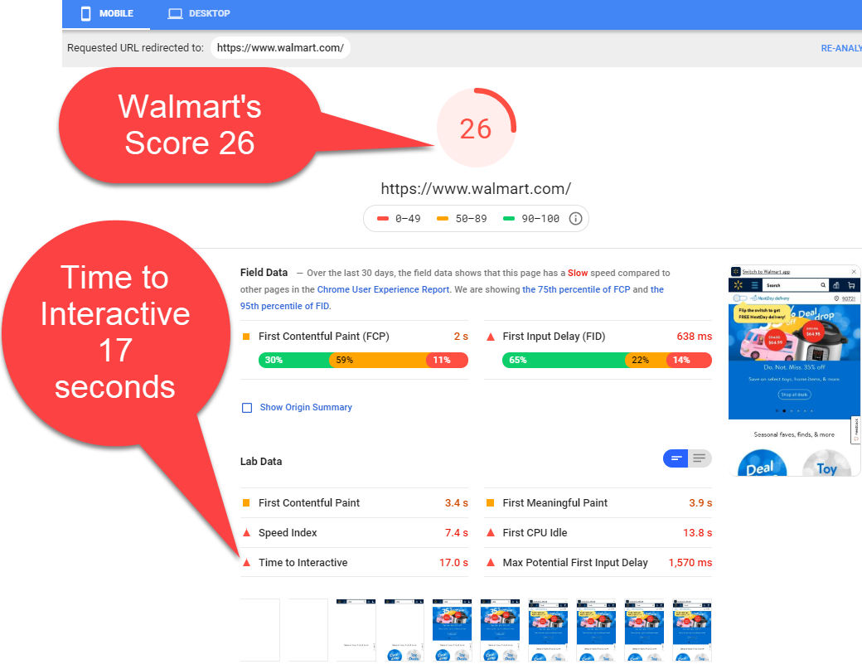
Amazon Vs Walmart
TTI Scores make a difference

Slide 4
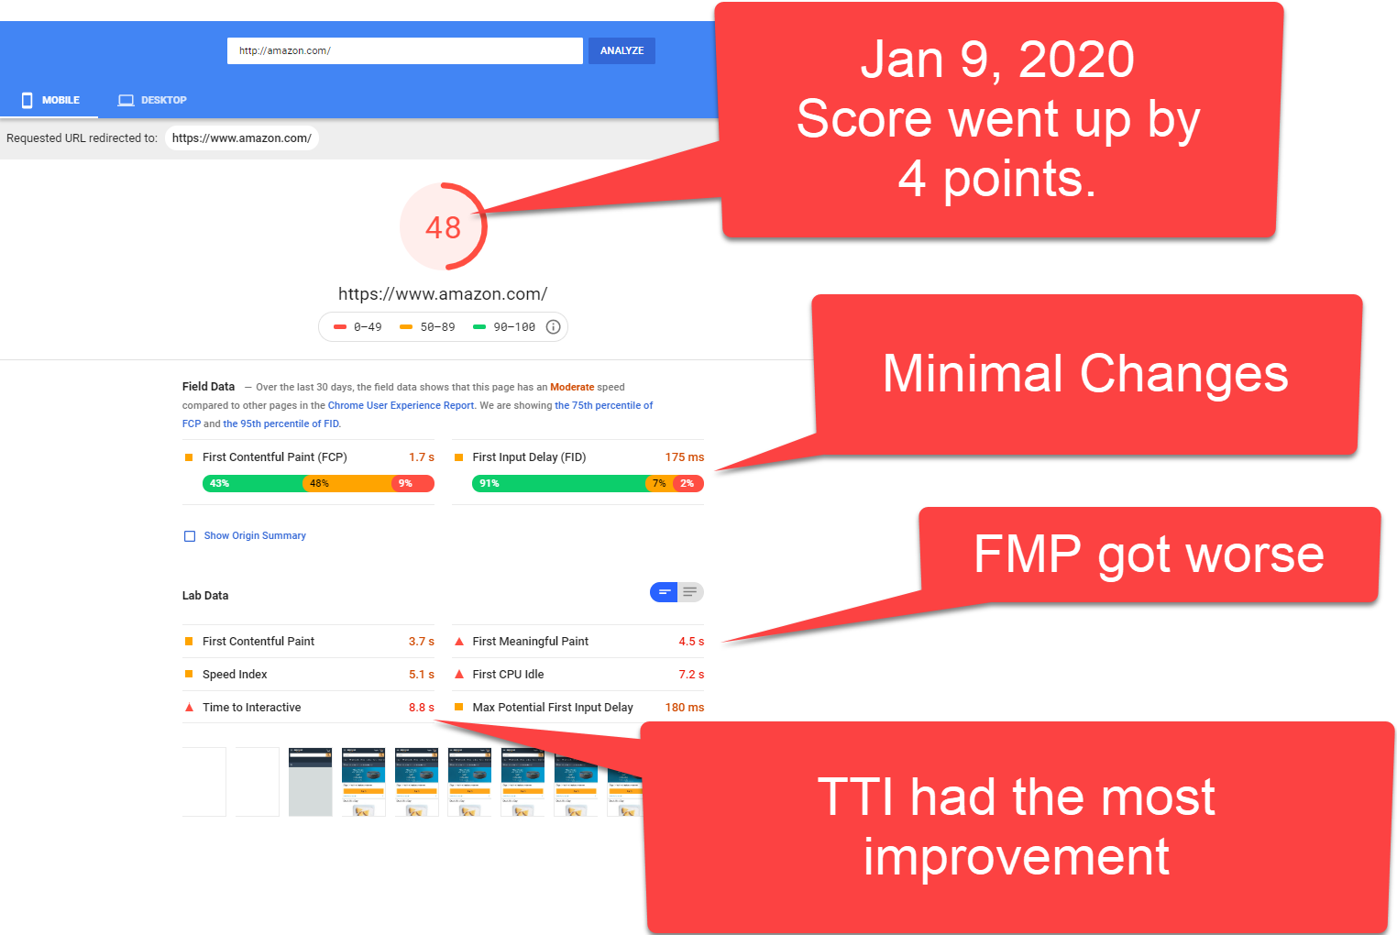
Amazon – November 2019 Vs January 2020
TTI Scores make a difference

Slide 5
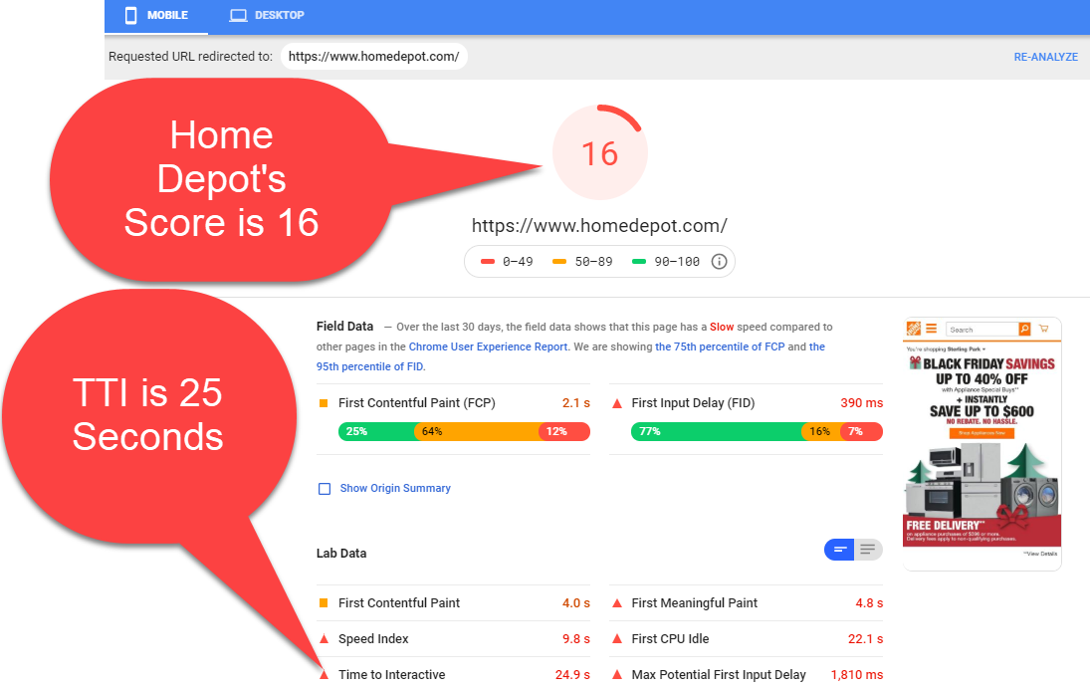
Home Depot Vs Lowe’s
Slower TTI Scores accompany lower Google Light House Scores

Slide 6
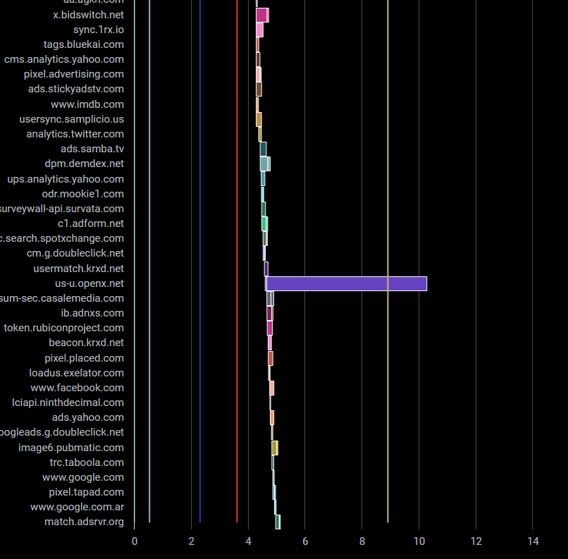
Legacy Approach to Solving Performance Issues
Analyze the Page Resource Timings for the slow Files, Objects, and API Calls
Using File and Object waterfalls are essential to finding slow loading files.
You can find Slow Loading Files and API Calls Improves Onload Event and other metrics like TTI but only address half of the issue.

Slide 7
Fixing TTI Requires More Than the Classic File and Ajax Waterfalls
Full Answer = Files + Function
Using File and Object waterfalls alone cannot tell the entire story.
Files and Ajax calls can be slowed by intensive JS Function Activity associated with browser rendering.
Files and Functions must be measured in tandem to understand how one influences the other.

Slide 8
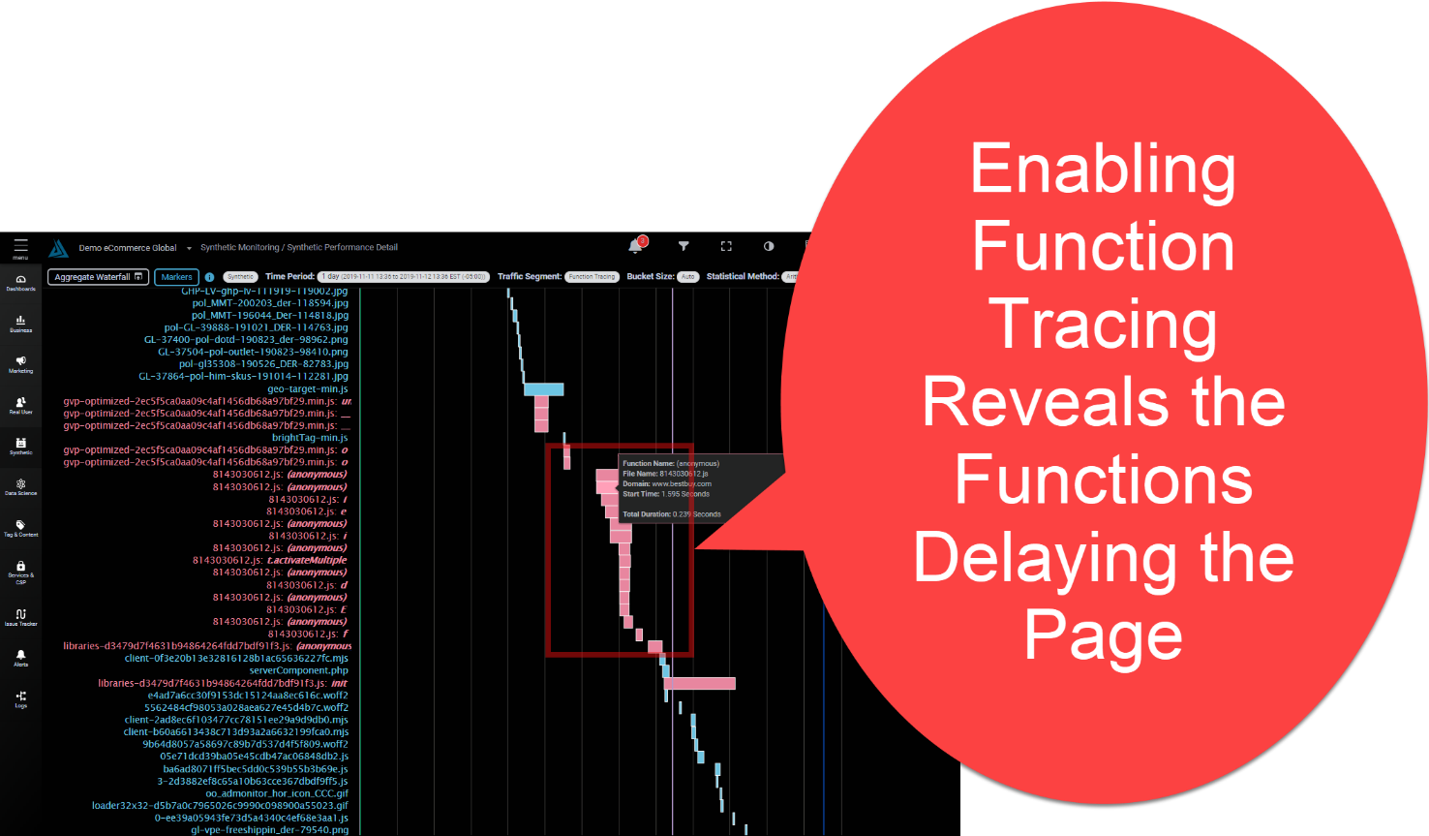
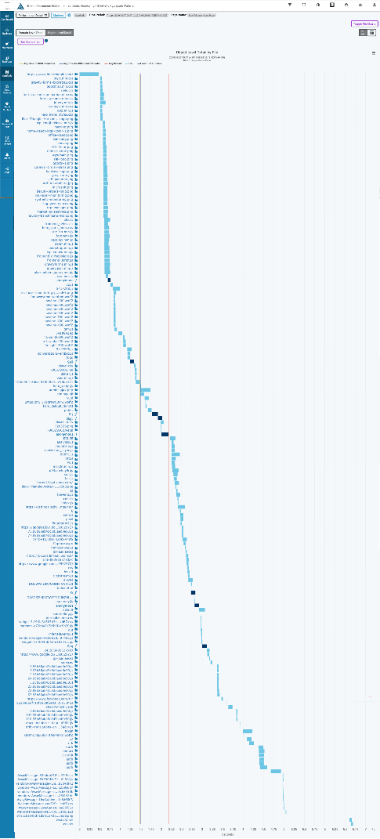
Function Tracing
Functions are in the Gap
Often the file waterfall shows gaps where the browser is rendering and javascript functions are running.
The ability to show/hide javascript activity can reveal which slow functions and from which files specifically are slowing the page.

Slide 9
Function Tracing Shows Function Timings
Function Tracing Shows the File and Function name or Anonymous if the function was anonymous
The mouseover also shows the Domain and Timing details for the duration of the function.

Slide 10
Synthetic Configuration Page
The Function Tracing is at the bottom of the Synthetic Config Page.

Slide 11
Q & A

Slide 12
Thank You
Contact Us
General Inquires: info@bluetriangletech.com
Sales: sales@bluetriangletech.com
Support: support@bluetriangletech.com
Call Us: +1 (877) 258-3107

